Slide 1
Software Developer Salary Prediction System
Group No. 21
02 : Zuhair Bhati
05: Ayush Dubey
15 : Ajay Pandey
Guided by Prof. Rahul Jiwane

Slide 2
Introduction
In this presentation, we are going to introduce the basic understanding of our mini project.
The following presentation includes the procedures starting from project idea, abstract, scope of project, literature review, Software and hardware requirements, comparative study, proposed model, conclusion and future scope.
Through this system a software developer can predict his/her salary according to the details provided.

Slide 3

Abstract
The goal of this project is to predict salary of a person after a certain year. The graphical
representation of predicting salary is a process that aims for developing computerized system to
maintain all the daily work of salary growth graph in any field and can predict salary after a
certain time period. This application can take the database for the salary system from the
organization and makes a graph through this information from the database. It will check the
salary fields then import a graph which helps to observe the graphical representation. And then it
can predict a certain time period salary through the prediction algorithm. It can also be applied in
some other effective prediction also .

Slide 4
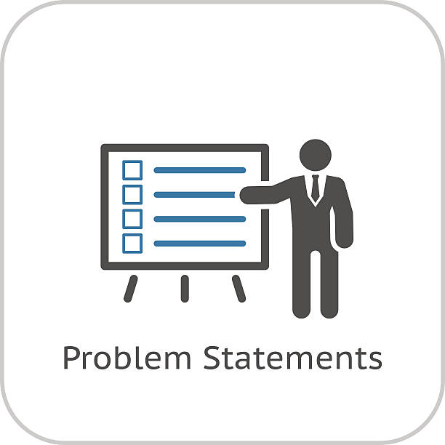
Problem Statement
Sometimes developers are confused while making a choice to select a job on the basis of the salary he/she will get.
Also, the salary is different for different states and countries so it gets more tiring to get all the information.

Slide 5

Literature review
SALARY PREDICTION USING REGRESSION TECHNIQUES (Sayan Das(JIS College of Engineering, Kalyani, Nadia)
The goal of this paper is to predict salary of a person after a certain year. The graphical representation of predicting salary is a process that aims for developing computerized system to maintain all the daily work of salary growth graph in any field and can predict salary after a certain time period.
Implement of salary prediction system to improve student motivation using data mining technique (Publisher: IEEE)
This paper presents a salary prediction system using a profile of graduated students as a model. A data mining technique is applied to generate a model to predict a salary for individual students who have similar attributes to the training data.
SALARY PREDICTION USING MACHINE LEARNING (Prof. D. M. Lothe1 , Prakash Tiwari2 , Nikhil Patil3 , Sanjana Patil4 , Vishwajeet Patil5)
Now a day’s prediction engine has become so popular that they are generating accurate and affordable predictions just like a human, and being using industry to solve many of the problems. Predicting justified salary for employee is always being a challenging job for an employer.

Slide 6

Scope of Project
Helping to see the growth at any field.
With the help of machine learning it can easily produce a graph.
Marketing easy to estimate the salary between x-y axis.
User can give any point to get the salary through the program.
Salary of the employees can be observed to give them a particular field according to their qualifications

Slide 7



System Specification
Hardware Requirements
Processor : Intel i3/i5/i7
Hard Disk : 500 GB internal storage drive
Memory : 2 GB RAM
Software Requirements
Windows 8 or Above
Python with anaconda.
Jupyter notebook.
Stream Lit (Python Library for Web App)
Data : Stack Overflow Developer Salary Survey.

Slide 8
System Architecture Diagram
Data Collection
Analysing Data Set
Data Cleaning
Evaluating the algorithms and improving the accuracy
Result Analysis and transforming it to Web App
Model Building

Slide 9
Implementation
Implementation of this project is done in two phases :
1. Cleaning , building model and analysing the prediction algorithms in Jupyter Notebook.
2. Replicating the accurate model in Stream Lit library for Web App.

Slide 10
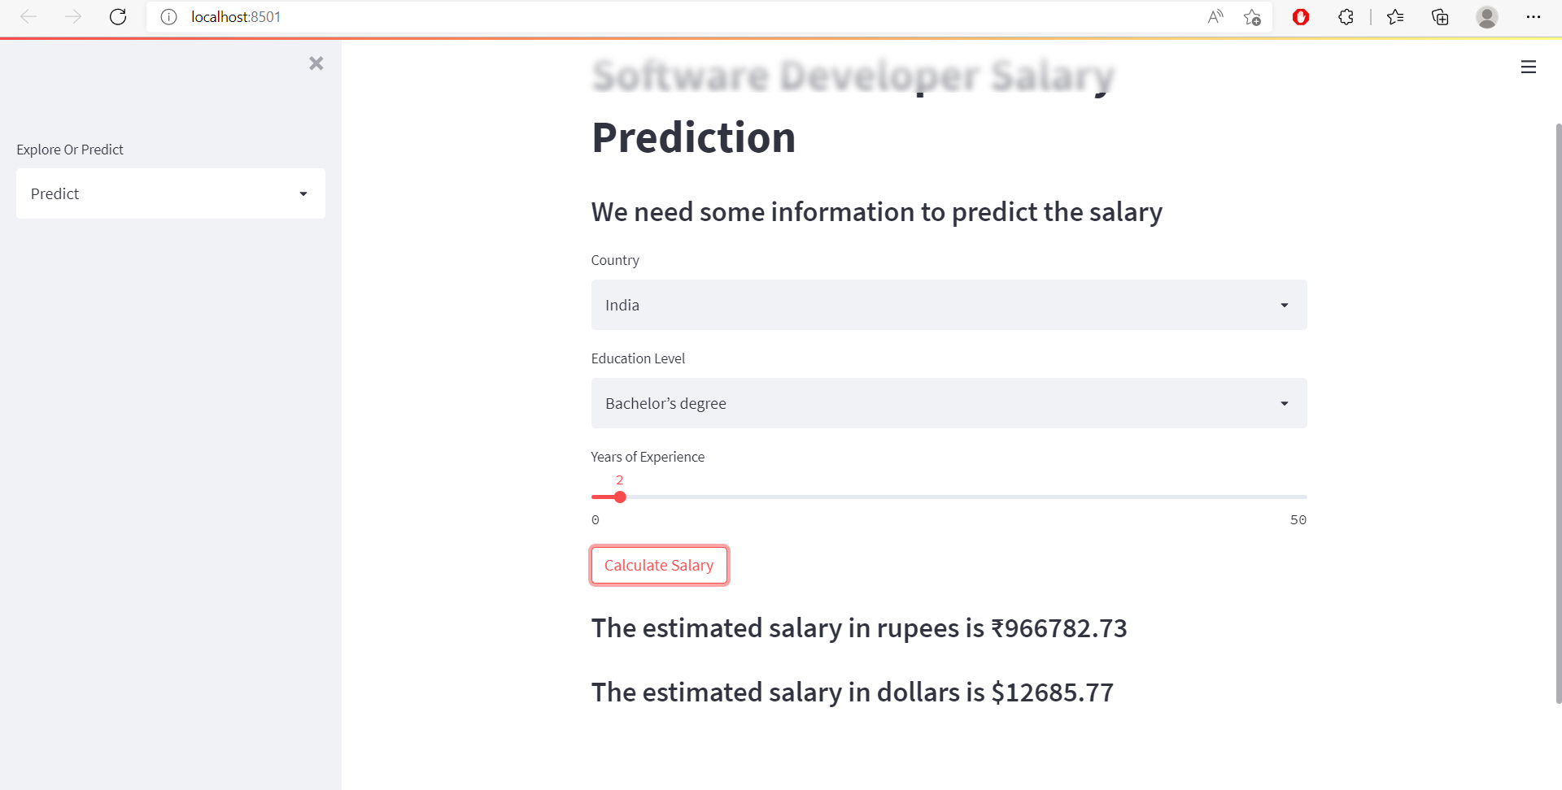
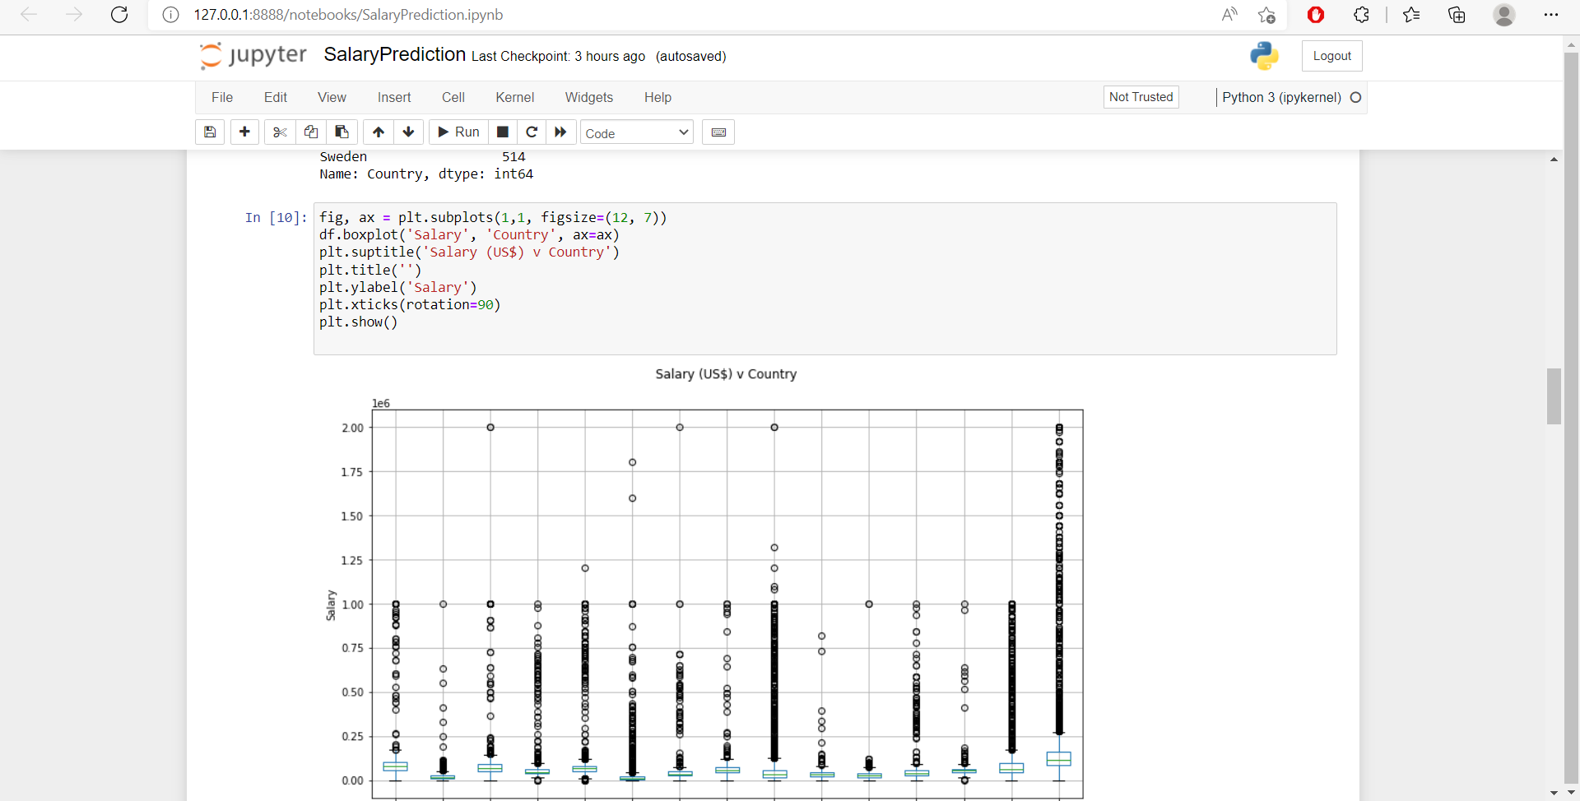

Slide 11

Conclusion and Future Scope
A prediction is an assumption about a future event. A prediction is sometimes, though not always, is based upon knowledge or experience. Future events are not necessarily certain, thus confirmed exact data about the future is in many cases are impossible, a prediction may be useful to help in preparing plans about probable developments.
Our model gives a solution by constructing a Machine Learning based DecisionTreeRegressor model. It is inclusive of all the parameters needed to evaluate the estimated salary of a software developer.
In Future we can improve the accuracy by analysing a larger data-set which has more precise information. Also more parameters can be provided to user while seeing the estimated salary.

Slide 12
References
SALARY PREDICTION USING REGRESSION TECHNIQUES
https://www.researchgate.net/publication/339055809_Salary_Prediction_Using_Regression_Techniques
S. Marsland, Machine learning: an algorithmic perspective. CRC press, 2015.
Sananda Dutta, Airiddha Halder, Kousik Dasgupta,” Design of a novel Prediction Engine for predicting suitable salary for a job” 2018 Fourth International Conference on Research in Computational Intelligence and Communication Networks (ICRCICN).

Slide 13
Thank You !!

